Slide 1
Software Testing and Quality Assurance
Haiming Liu
liuhaiming@bjtu.edu.cn
School of Software Engineering
Beijing Jiaotong University

Slide 2
16 Weeks Plan
Week 1: The basic concepts and theories of testing
Week 2-3: Principles of Testing
Week 4: Testing the specification
Week 5-8: Black Box Testing
Week 9-12: White Box Testing
Week 13: Integration Testing and System Testing
Week 14: Integration Testing and System Testing
Week 14: Usability Testing and Accessibility Testing
Week 15: Software Quality
Week 16: Review

Slide 3
Topics in Testing Software
Usability

Slide 4

Software Usability
Eventually a person will interact with a software system.
Software usability is how:
appropriate
functional
effective
that interaction is.
Ergonomics is the science of designing everyday things so that they are easy and functional to use.

Slide 5
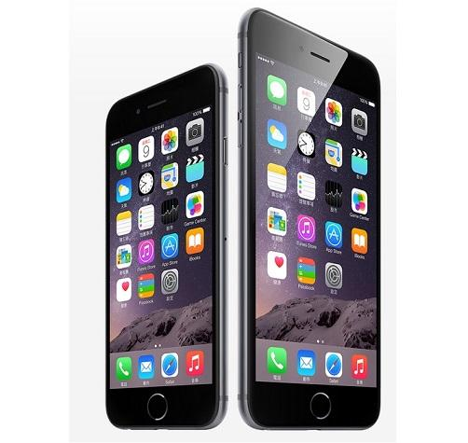
Important traits of a good UI
Follows standards and guidelines
Intuitive
Consistent
Flexible
Comfortable
Correct
Useful

Slide 6
Follows UI standards and guidelines
Macintosh Human Interface Guidelines
http://developer.apple.com/documentation/UserExperience/Conceptual/OSXHIGuidelines/XHIGIntro/chapter_1_section_1.html
Microsoft Windows User Experience
http://msdn2.microsoft.com/en-us/library/aa511258.aspx
These guides detail how software that runs on each platform should look and feel to the user.
When should a check box be used instead of a button?
When is it proper to use information, warning, or critical messages?

Slide 7
Follows UI standards and guidelines (cont’d)
The standards guidelines for a platform should be treated as an addendum to the product specification.
Test cases should be created based on the standards guidelines in addition to the test case created from the product’s specification.
If the development platform does not have a standard, the design team must create usability standards for the software itself.

Slide 8
Intuitive UI
Is the UI clean, unobtrusive, not busy?
Are responses obvious and there when you expect them?
Is the UI organized and laid out well?
Are the inputs acknowledged?
Do the menus go too deep?
Is there excessive functionality?
Is there information overload?
Does the help system really help the user?

Slide 9
Consistent UI
Shortcut keys and menu selections
F1 should always get you Help in MS Windows.
Different UI paths should have the same F key to execute a feature.
Terminology and naming
Is Find sometimes called Search?
Audience
Consider the success of the UI of the car and ATM.
Placement of buttons such as OK and Cancel
In Mac OS, the OK button is always on the right.
In MS Windows the, the OK button is on the left and Cancel is on the right.

Slide 10
Flexible UI
Users like choices … but not too many.
E.g., MS simple and scientific calculators
Flexible UIs provide:
State jumping
Many alternative ways to achieve the same goal.
State termination and skipping
“If you know your party’s extension enter it at any time”.
Multiple ways to perform I/O
Excel allows many input formats (from keyboard or files) and many output formats (table, graphs, charts).

Slide 11
Comfortable UI
Sounds like a strange notion …
Is the UI appropriate?
Sound effects in a computer game? How about a business application?
Does the UI handle errors well?
If there is no Undo/Redo feature critical operations may fail.
Is the feedback fast enough or too fast?
E.g., waiting for cash to come out of the ATM
Does excessive use cause harm?
E.g., Emacs hand

Slide 12
Correct UI
Marketing differences
Are there extra or missing functions from what the marketing material states?
Language and spelling
Error messages often have spelling mistakes
Bad media (icons, images, sounds, videos) that for with the software UI.
WYSIWYG
E.g., does the printed Adobe Acrobat file look like the one on the screen?

Slide 13
Useful UI
When testing a UI feature, ask if the feature you see actually contributes to the software’s value.
Many applets have useless features
Useless UI features waste time for the user, developer, and tester.

Slide 14
Topics in Testing Software
Accessibility

Slide 15
Accessibility Testing (testing for the disabled)
The following impairments make using computers especially difficult:
Visual
E.g., color blindness, tunnel vision, cataracts.
Hearing
E.g., partial or complete deafness.
Motion
E.g., injury can make using a keyboard or mouse difficult or impossible.
Cognitive and language
E.g., dyslexia or memory problems and using complex UIs

Slide 16
Accessibility features in software
If the software being tested does not run on a platform that has specified accessibility features?
Accessibility features will have to be specified, programmed, and tested.
If your platform has built in accessibility features your software?
Software only needs to adhere to the platform’s standard for communicating with peripheral devices.
Remember to create test cases specifically to test for accessibility.
Add them to your configuration testing equivalence partitions.

Slide 17
Microsoft Windows accessibility features
Sticky-keys: Allow Shift, Ctrl, Alt keys to stay in effect until the next key is pressed.
Filter-keys: prevents brief repeated keystrokes from being recognized.
Toggle-keys: plays tomes when Caps Lock, Scroll Lock, or Num Lock keyboard modes are enabled.
Sound-sentry: creates a visual warning whenever the system generates a sound.
Show-sounds: instructs program to display captions for any sounds or speech they make.

Slide 18
Microsoft Windows accessibility features (cont’d)
High contrast: sets up the screen with colors and fonts designed to be read by the visually impaired.
Mouse-keys: allows the use of keyboard keys instead of he mouse to navigate.
Serial-keys: sets up a communication port to read in key strokes from an external (non-keyboard) device.

Slide 19
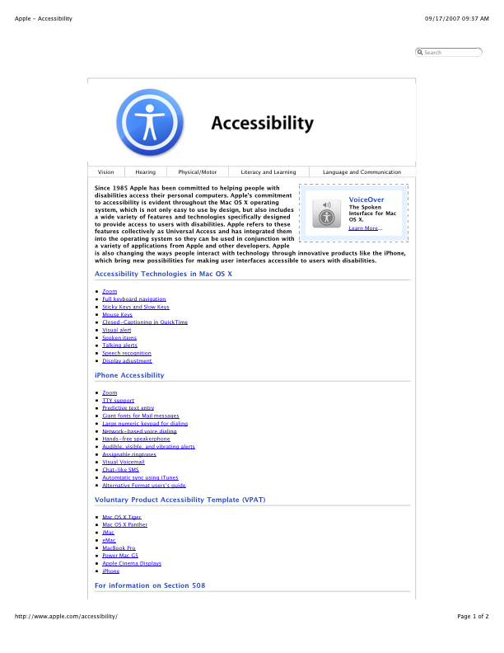
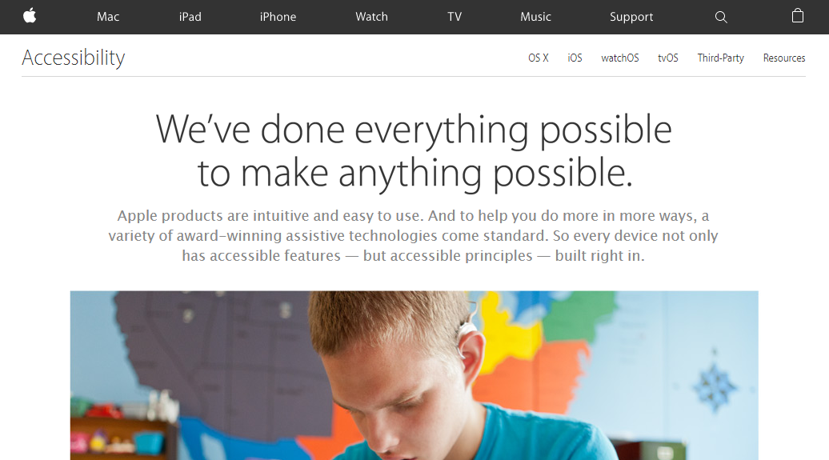
System Testing
Apple’s accessibility website

Slide 20
To be continued… See you next week

